Slide 1
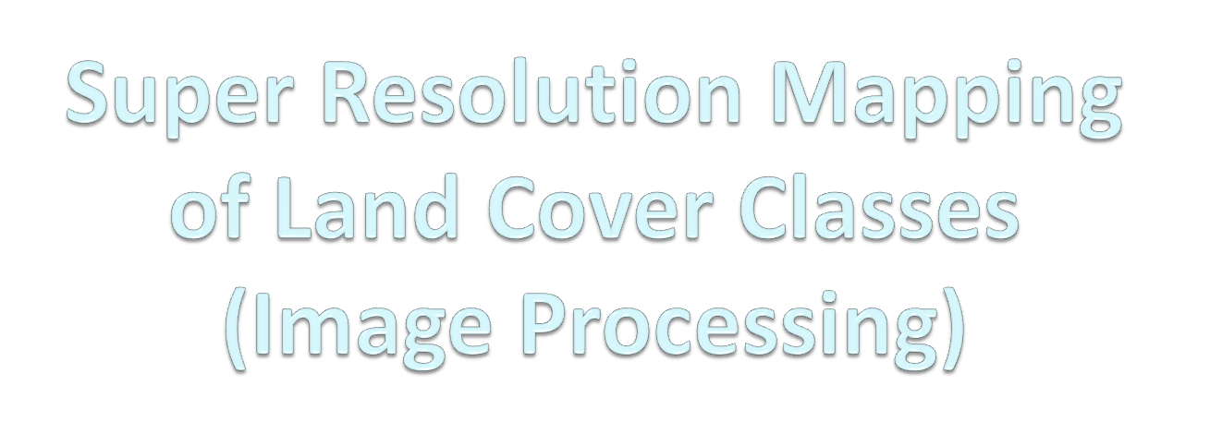
P.NAVEEN RAJ 2009115061
S.B.YUVARAJA 2009115118
YASWANTH KUMAR 2009115117
PROJECT GUIDE - DR.K.VANI, ASSOCIATE PROFESSOR, DEPT OF IST, ANNA UNIVERSITY
SLIDE NUMBER

Slide 2
INTRODUCTION
SLIDE NUMBER

Slide 3
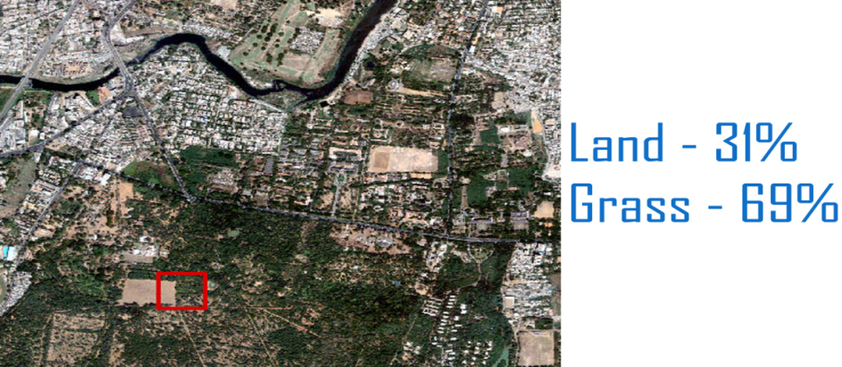
INTRODUCTION
Satellite images are used for preparing latest land cover maps .
Maps prepared through classification(Hard and Soft).
Hard classification is mapping of the one pixel to one class approximately.
Soft classification is finding of percentage of spectral components in the particular pixel.
SLIDE NUMBER

Slide 4
INTRODUCTION(COUNT..)
Super Resolution Mapping is the technique that is used to map the identified spectral components in a particular pixel.
SLIDE NUMBER

Slide 5
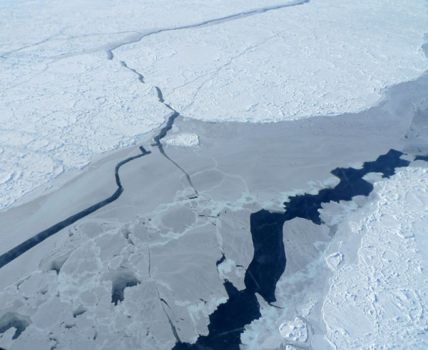
ISSUES IN EXISTING SYSTEMS
Satellite images having lesser resolution will provide land cover mapping with poor accuracy
SLIDE NUMBER

Slide 6
SOLUTION
Usually one pixel may contain mixed information - Soft Classification preferred.
Soft classification is a technique to predict proportions of land cover classes within mixed pixels using sub pixel classification
Super resolution mapping(SRM) is a technique to predict spatial locations of land cover classes within mixed pixels in remotely sensed imagery using the sub pixel mapping(SPM)
For the SRM we use two step approach
two-step approach first estimates fraction images by spectral un mixing and then inputs fraction images into an SPM algorithm to generate the final sub pixel land cover map
SLIDE NUMBER

Slide 7
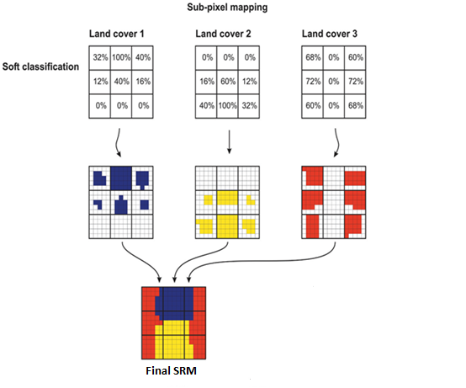
Example
SLIDE NUMBER

Slide 8
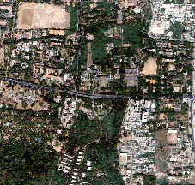
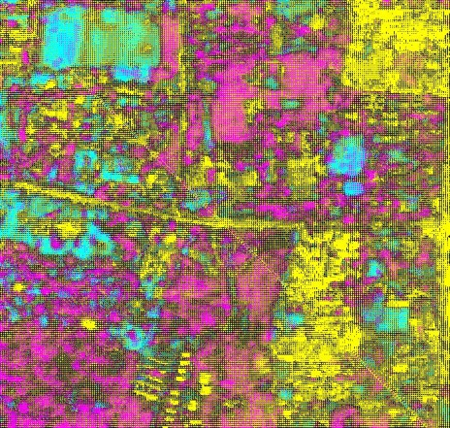
Original image :
Image after processing :

Slide 9
Literature survey
Subpixel Land Cover Mapping by Integrating Spectral and Spatial Information of Remotely Sensed Imagery,2011 – (Feng Ling , Yun Du , Xiaodong Li)
Main aim of this work is to retrieve final sub pixel land cover map from the remotely sensed image
linear un mixing model (LUM) is used for spectral un mixing
Maximal spatial dependence model is adopted for SPM
SLIDE NUMBER

Slide 10
Literature survey – cont..
Spectral and spatial goal functions are combined to form a single optimization function
Min E ( r )= Espectral( r )+λ Espatial( r )
Limitation :
Correlation with nearest pixel is not considered
Attraction between the classes with in the pixel is not consisdered
SLIDE NUMBER

Slide 11
Literature Survey
Super-resolution land cover pattern prediction using a Hopfield neural network July-2011 - Quang Minh Nguyen, Peter M. Atkinson & Hugh G. Lewis
Super Resolution Mapping with Hopfield Neural Network using the soft classified proportions is used.
PAN and MS images are processed and compared to find spatial dependence
LIMITATION :
It can provide only local optimization
SLIDE NUMBER

Slide 12
Literature Survey
Particle swarm optimization-based sub-pixel mapping for remote-sensing Imagery , may 2012 - Qunming Wang, Liguo Wang & Danfeng Liu
Applying PSO(Particle Swarm Optimization ) algorithm for proportion images.
Integrate the classification map for all classes.
Final SRM map will be obtained
SLIDE NUMBER

Slide 13
OBJECTIVE
Soft Classification of image :
Spectral components of various classes are identified
Super Resolution Mapping :
Spatial dependence is realized in simple and effective way using attraction and Co-Relation
To obtain more accurate land cover maps from coarser spatial resolution images.
SLIDE NUMBER

Slide 14
General steps
Sub divide the pixel
Allocate the classes randomly according to the area proportion.
Calculate the attraction and correlation between the sub pixels
Applying PSO(Particle Swarm Optimization ) algorithm for all proportion images.
Integrate the classification map for all classes.
Final SRM map will be obtained
SLIDE NUMBER

Slide 15

SLIDE NUMBER

Slide 16
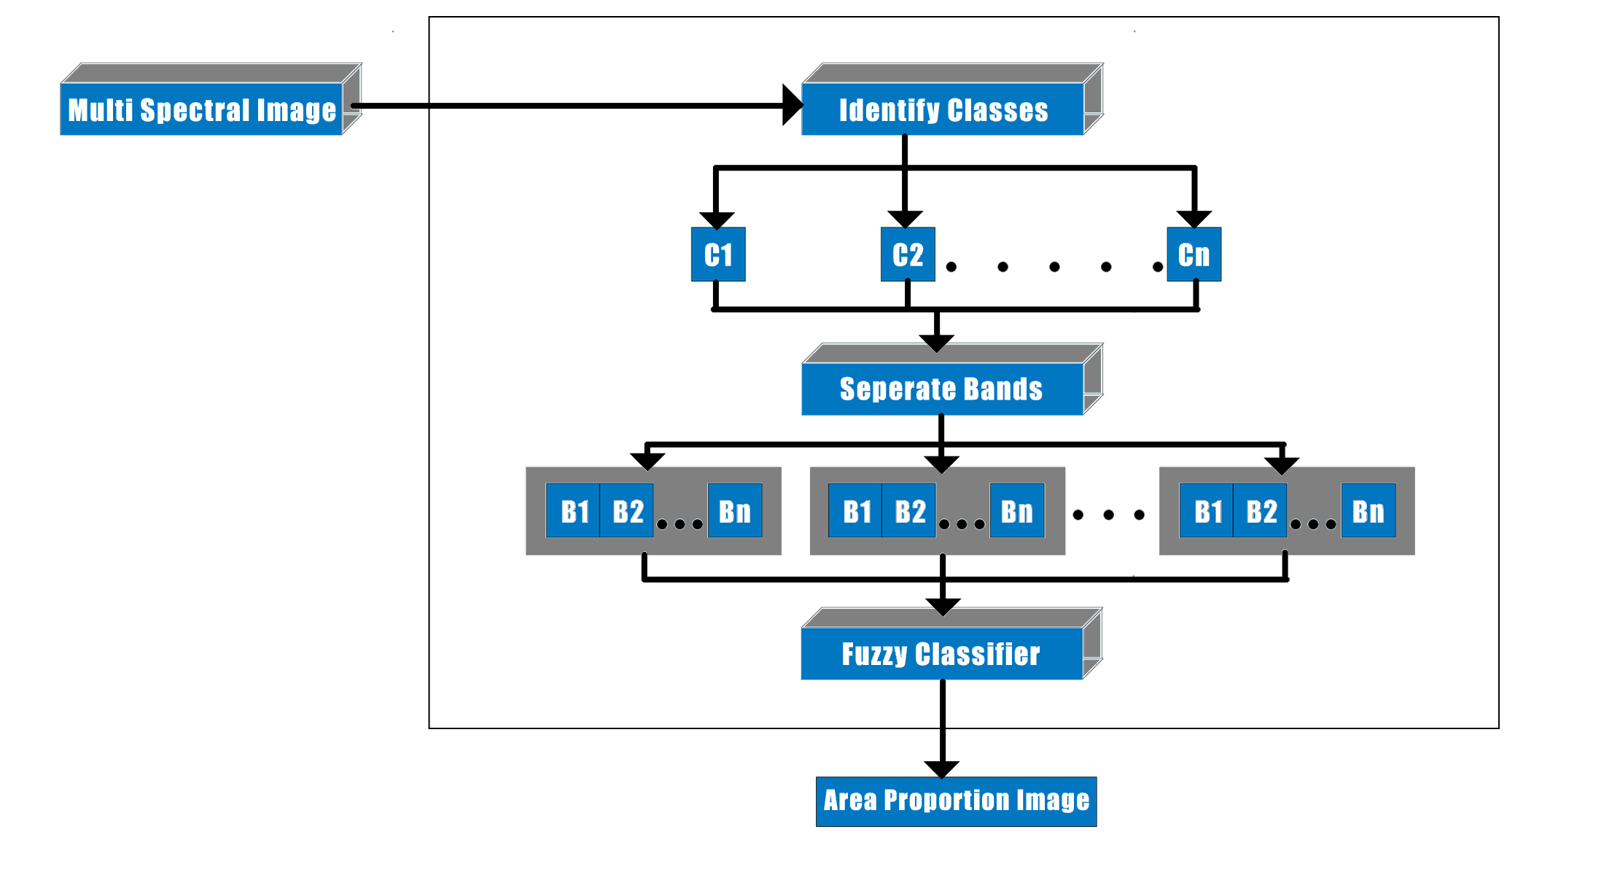
ARCHITECTURE
SLIDE NUMBER
15

Slide 17
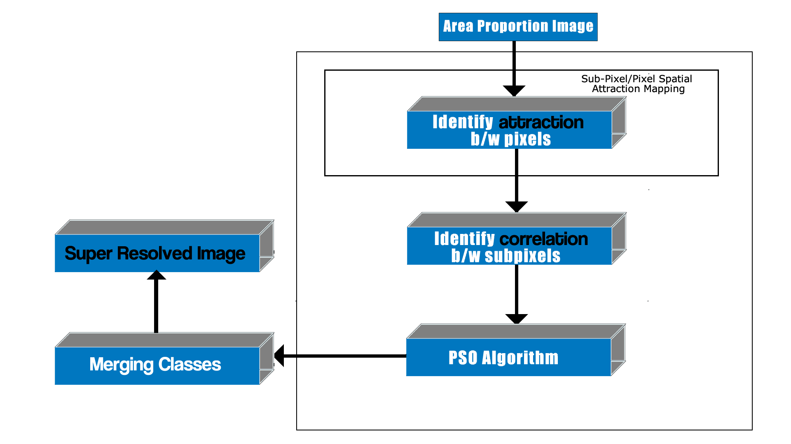
ARCHITECTURE
SLIDE NUMBER

Slide 18

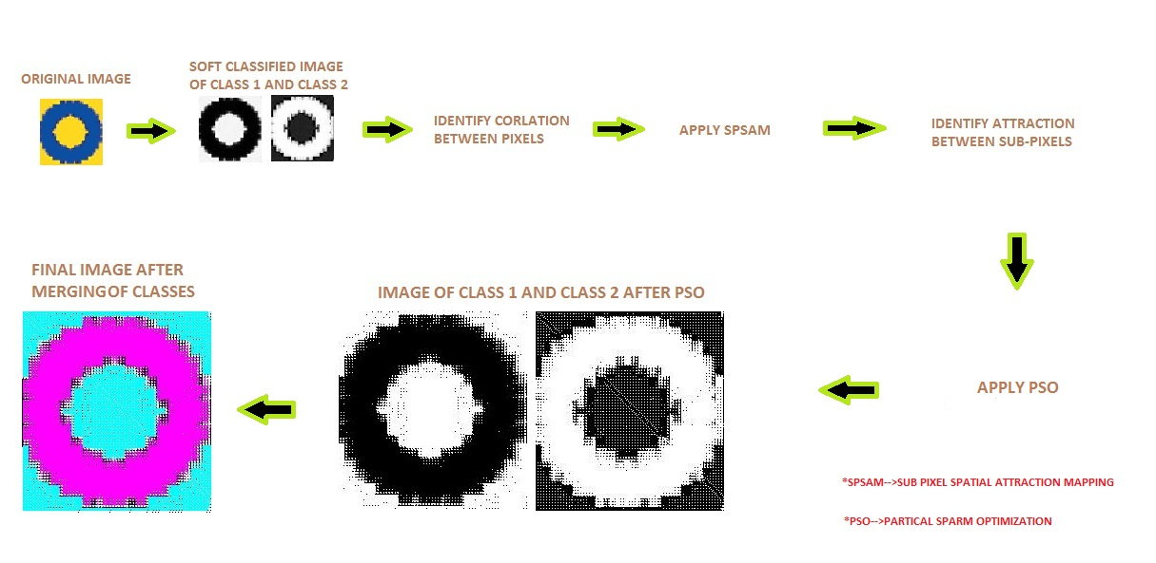
SLIDE NUMBER

Slide 19

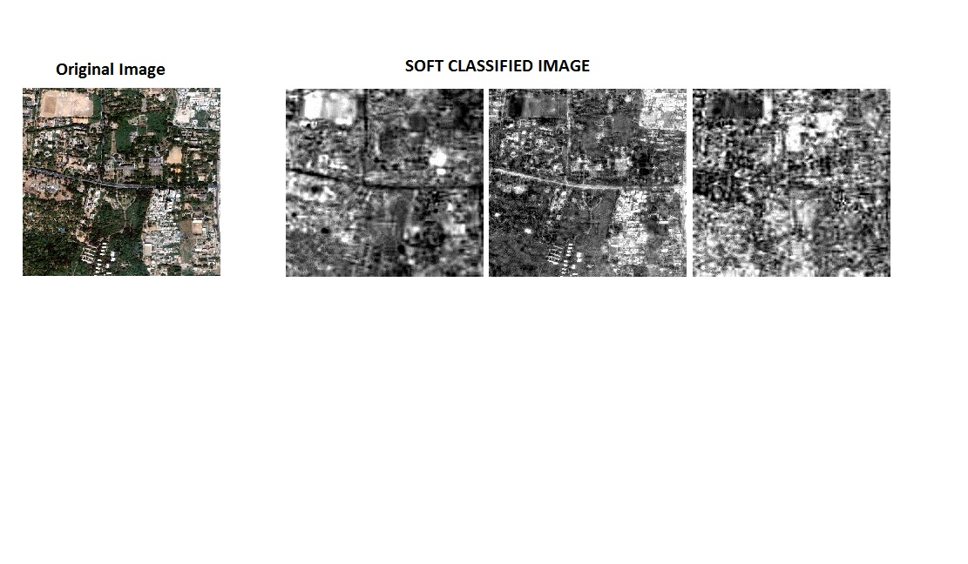
SLIDE NUMBER

Slide 20
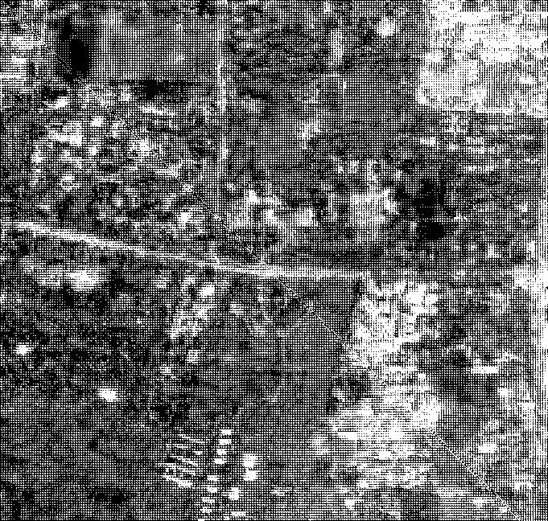

SLIDE NUMBER

Slide 21
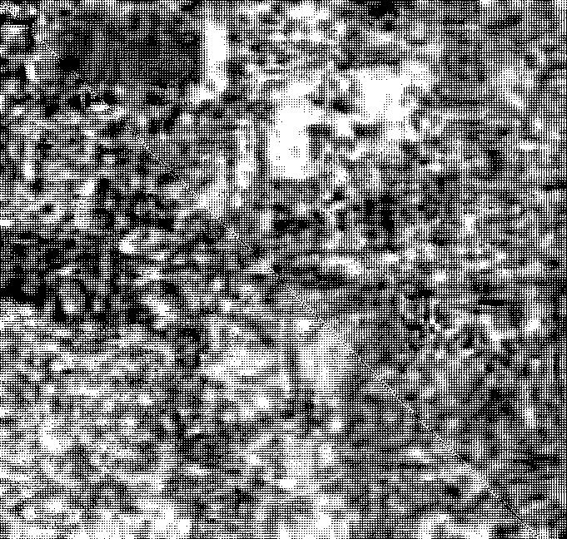

SLIDE NUMBER

Slide 22
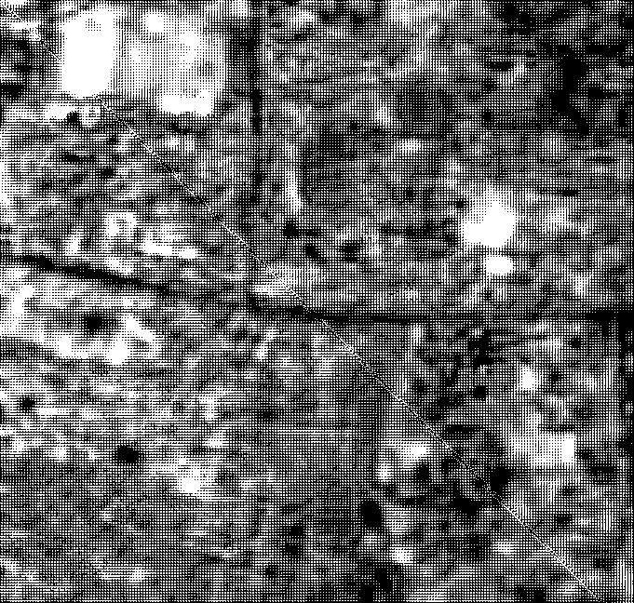
SLIDE NUMBER

Slide 23
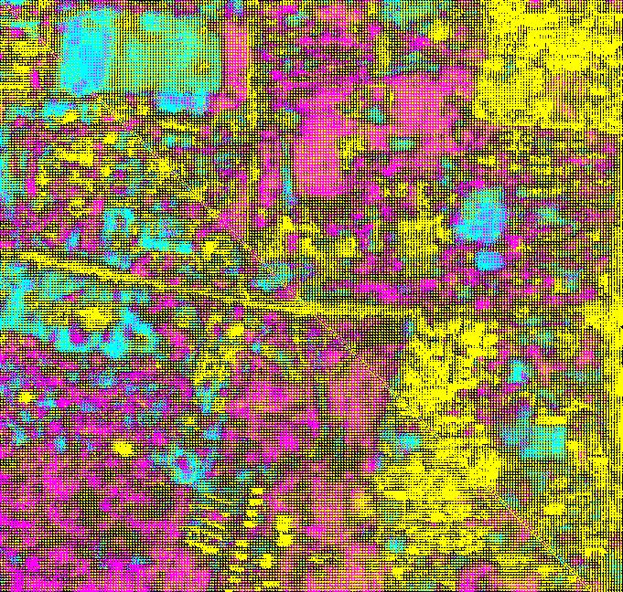

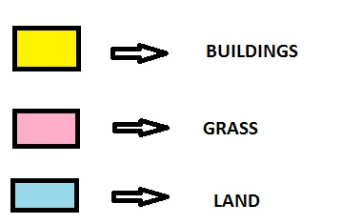
SLIDE NUMBER

Slide 24

SLIDE NUMBER

Slide 25

SLIDE NUMBER

Slide 26
SLIDE NUMBER

Slide 27

SLIDE NUMBER

Slide 28
COMPARING PSO AND ANT COLONY OPTIMIZATION
PSO :
More accuracy
Time required is fixed
ANT COLONY OPTIMIZATION :
Have unclassified class
Time required cannot be fixed
SLIDE NUMBER

Slide 29
Technologies/Tools Used
Requirement | Technology
Operating System | Microsoft Windows 7
Programming Language | MATLAB
Integrated Development Environment | MATLAB R2009a
SLIDE NUMBER

Slide 30

With Split-Up For Each Member
SLIDE NUMBER

Slide 31
Naveen Raj | 1 . Soft Classification : ENVI tool is used to obtain area proportions image
 | 2 . Identifying attraction between sub pixels Attraction between the nearest pixel is found.
 | 3. Apply PSO Algorithm PSO algorithm is studied and applied.
 | 4. Comparing Results The Optimized and Original PSO are compared.
SLIDE NUMBER

Slide 32
Yuvaraja | 1 . Soft Classification : ENVI tool is used to obtain area proportions image
 | 2. SPSAM is Applied SPSAM is studied and applied.
 | 3 . Correlation between sub-pixels The correlation between neighboring sub-pixels.
 | 4. Optimizing PSO and ANT colony The existing PSO is optimized.
SLIDE NUMBER

Slide 33
Yaswanth | Apply PSO Algorithm PSO algorithm is studied and applied.
 | 2 . Merging of classes Various band matrix’s are combined and for each class matrix formed.
 | 3 . Optimizing PSO and ANT colony The existing PSO is optimized.
SLIDE NUMBER

Slide 34
Progress Since Last Review
PSO Algorithm has been Optimized.
ANT colony algorithm is implemented
Results are compared
SLIDE NUMBER

Slide 35

With Expected Outcome
SLIDE NUMBER

Slide 36

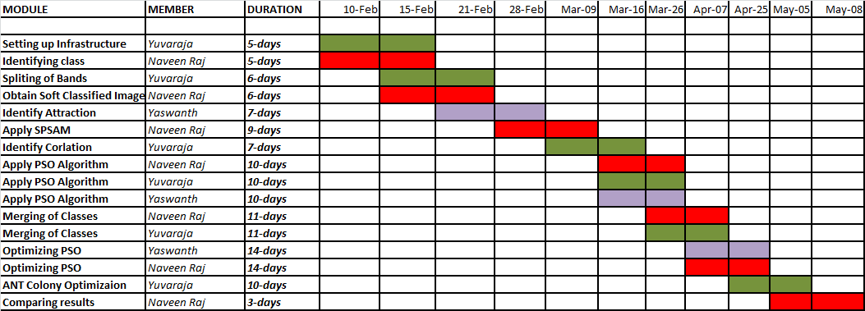
SLIDE NUMBER

Slide 37
References
A. J. Tatem, H. G. Lewis, P. M. Atkinson, and M. S. Nixon, “Super-resolution land cover pattern prediction using a Hopfield neural network,” Remote Sens. Environ. , vol. 79, no. 1, pp. 1–14, Jan. 2002
Feng Ling, Yun Du, Fei Xiao, and Xiaodong Li“Subpixel Land Cover Mapping by Integrating Spectral and Spatial Information of Remotely Sensed Imagery” IEEE GEOSCIENCE AND REMOTE SENSING LETTERS., 2011 IEEE
P. M. Atkinson, “Issues of uncertainty in super-resolution m apping and their implications for the design of an inter-comparison study,” Int. J.Remote Sens., vol. 30, no. 20, pp. 5293–5308, Oct. 2009
A. J. Tatem, H. G. Lewis, P. M. Atkinson, and M. S. Nixon, “Super-resolution target identification from r emotely sensed images using a Hop-field neural network,” IEEE Trans. Geosci. Remote Sens. , vol. 39, no. 4, pp. 781–796, Apr. 2001
SLIDE NUMBER

Slide 38
THANK YOU
SLIDE NUMBER

